Slide 1

Web development basics
Week 1

Slide 2
Objectives
1. How Web Browsing Works
2. Introduction to HTML
3. HTML Essentials
4. Cascading Style Sheets

Slide 3
WEB BROWSER
A web browser, also known as an internet browser or simply a browser, is a software application that lets people access the World Wide Web(WWW). It’s a one-click window to the entirety of human knowledge — you can search for the answer to any question you might have.
Web browser examples:
Google Chrome
Safari
Microsoft Edge
Mozilla Firefox
Opera

Slide 4
1. HOW WEB BROWSING WORKS
Before getting into web programming it’s important to understand how web browsing works.
When you open your browser and visit a site such as www.youtube.com, the browser invisibly performs a lot of tasks to display that page to you.
The first thing it must do is contact the web server at www.youtube.com.
The server sends back the latest content to the browser – recent videos, comments and advertising that have been added to the site since you visited it last. Sometimes there will have been few changes, and the site will load quickly.
Other times, there will be many changes, and you will have to wait while your browser loads all the new content.
This content is sent to the browser embedded within special HTML commands (some of these will be covered in a later Topic).
These commands tell the browser what colours, fonts and other styles to use when it displays the content, and how to position the content on the page.
Positioning is also called “Page Layout”, again an important Topic for later.
The browser removes the commands from the user's view, interprets them, and shows the user only the actual content. This process of removing the commands, interpreting them, and displaying the content in accordance with the commands is called rendering.

Slide 5
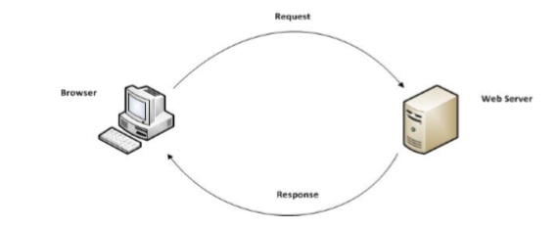
Explanation
When the user clicks one of these links, the browser contacts the web server at the URL contained within the link, and the process begins again.
The picture shows the basic operation of a browser requesting the content and the web server responding to the browser request.

Slide 6

HTML is the most important component for building websites, web apps and anything else that’s delivered via the web.
TAGS ARE HTML ESSENTIALS

Slide 7
URL
Taking YouTube as an example, www.youtube.com is the URL (Uniform Recourse Locator), often simply called an “address”. Every web page displayed in your browser has a unique URL.
Your browser will show the current URL at the top of every page in a long text box. This URL will change to the URL of the new page whenever you click a link.
You can also type an address directly into the URL area of your browser and press Enter to load any page you wish. Usually, the URL contains a prefix of 'http://', but when typing an address, you can leave that part off and the browser will add it in for you.
HTTP (Hypertext Transfer Protocol) is the set of rules for transferring files -- such as text, images, sound, video and other multimedia files -- over the web. As soon as a user opens their web browser, they are indirectly using HTTP.
For more information, see URLs in Depth, below

Slide 8


Web Server
Web servers are computers that store all the pages and content for a web site.
They may be located anywhere in the world, as long as they are connected to the Internet. They are operated by the person or organisation that owns the site.
Amazon Web Services offers cloud web hosting solutions that provide businesses, non-profits, and governmental organizations with low-cost ways to deliver their websites and web applications.

Slide 9
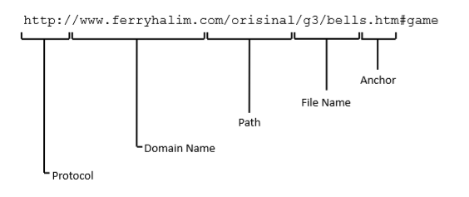
URLs in Depth
People like to share URLs with each other via email or social sites like Facebook, but they do not usually share the URL of a top-level page such as www.youtube.com. More often, the URL links to something they found funny, interesting or useful. Let us look at an example.

Slide 10
Protocol
The first part of the URL is the protocol. In this course we will always use http, which means HyperText Transfer Protocol. It is by far the most common protocol on the web.
The protocol is separated from the rest of the URL by a colon and two forward-slashes.
Domain Name
The second part of the URL (www.ferryhalim.com) is the domain name, which is the web server's unique name. No server in the web can have the same domain name as another.
Path
The third part of the URL (/orisinal/g3/) is the path. Each name in the path is separated by a forward-slash and is the name of a folder on the server. The server follows the path to find the file that your browser wants.
From the path in this example, we can see that within its topmost folder the server must contain a folder called 'orisinal', and within the 'orisinal' folder there must be another folder called 'g3'.

Slide 11
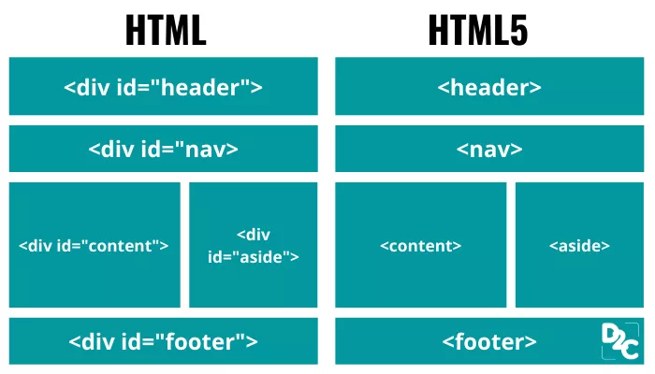

Slide 12
INTRODUCTION TO HTML5
HTML (HyperText Markup Language) is a markup language for structuring and presenting content for the World Wide Web.
HTML has gone through many revisions since its release and the current standard is 4.1, though HTML 5 which is the fifth revision is currently under development but has yet to be released at the time of writing (November 2013) though some of the HTML5 specifications are supported by newer browsers.
In addition to HTML you should be aware of XHTML (eXtensible HyperText Markup Language). The current version of XHTML is 1.1. XHTML is just HTML rewritten with XML (eXtensible Markup Language) rules.
Sounds confusing right? Well simply put XHTML 1.1 can be thought of as an extended version of HTML 4.1 that has some stricter rules that must be adhered to when using it.

Slide 13
<XHTML>
XHTML is case sensitive and applies a rule that all tags (and attributes) must be in lowercase whilst there is no such restriction in HTML.
For consistency reasons we will follow XHTML rules throughout this learning guide.
The core aim of the new version of HTML (HTML5) is to improve the language with support for the latest multimedia while keeping it easily readable by humans and consistently understood by web browsers.

Slide 14
HTML Basics
HTML itself uses text surrounded by angled brackets to indicate how content should be rendered in the browser. The text with angle brackets is referred to as a tag. A pair of tags holding some text (or content) is referred to as an element. <>
The first tag of the pair is referred to as the opening tag and the second tag as the closing tag. The closing tag is always slightly different from the opening tag in that it has a forward slash after the first angled bracket < > </>

Slide 15
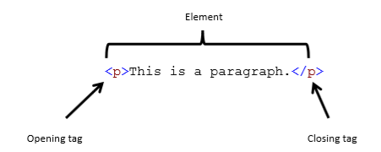
An example of a HTML element is shown below.

Slide 16
Sample HTML Code
<!DOCTYPE html> <html> <head> <title>Page Title</title> </head> <body> <h1>This is a Heading</h1> <p>This is a paragraph.</p> </body> </html>

Slide 17
HTML elements also come in a self-closing form
Rather than having an opening and closing tag, you have one tag that denotes both. An example is shown below.
<br />
The <br> HTML element produces a line break in text (carriage-return). It is useful for writing a poem or an address, where the division of lines is significant.

Slide 18
Attributes
Attributes contain additional information that changes the way a specific element behaves.
An example of an attribute is shown below:
<a href="https://www.southmetrotafe.wa.edu.au">Link to SMTAFE</a>

Slide 19
Explanation
Each attribute has two parts: a name and its corresponding value. The name is the property of the element that you want to set.
The value is what you want the value of the property to be. The value is enclosed in double quotes and comes after the attribute name separated by an equal sign.
In the previous example the <a> element is used to link one web page to another. The attribute named href is used to state what web page will be linked to. Note that in a browser the link will be shown as:
Link

Slide 20
More explanation
So the text between the open tag and the close tag is displayed in the browser with an underline to denote it as a link.
When this is clicked on by the user, the user is directed to the www.southmetrotafe.wa.edu.au because this is the href attributes value.
Building on from the previous example we have now added another attribute to our <a> element as shown below:
<a href=“https://www.southmetrotafe.wa.edu.au” target=_blank>Link to SMTAFE</a>
In the example above we have added another attribute named “target” which has the values of “_blank”
The target attribute allows us to determine where the new web page should be opened.
In this case the value “_blank” states that when the user clicks on the link a new window should be opened and this window will open the TAFE WEBISTE which is specified by the href attributes value.

Slide 21
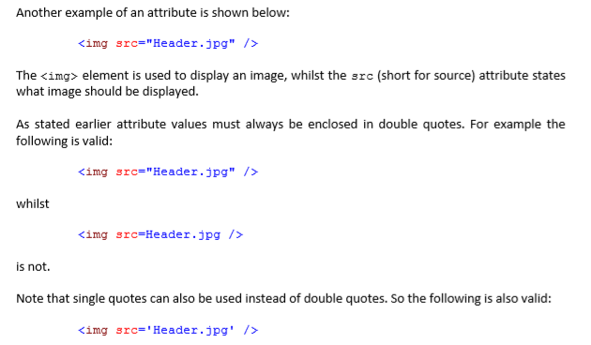

Elements can have several attributes

Slide 22
The Basic HTML Document

Slide 23
A HTML document
A HTML document should contain standard HTML tag pairs.
The document begins with the <html> tag and ends with the </html> tag.
Tags are standard markers which indicate that everything between the beginning tag <> and the end tag </> is to be formatted or acted upon in a certain way.
There are some tags which have no extra content so only have a single tag. These will be pointed out as we come to them.
The HTML document consists of two sections the head and the body.
The head contains the title and formatting links which affect the document as a whole.
The body contains the visual part of the document that is made up of paragraphs of text, lists, images and other elements.

Slide 24
Modern web browsers are programmed according to HTML specifications
Modern web browsers are programmed according to HTML specifications therefore they will display the information correctly when the tags are used correctly.
If the tags are not used correctly then all manner of strange outputs can result depending on the browser.
The required elements are shown in this basic document. The image on the left shows the raw HTML code as seen in Notepad. The image on the right shows what it looks like in a Web browser (in this case Microsoft Edge).

Slide 25
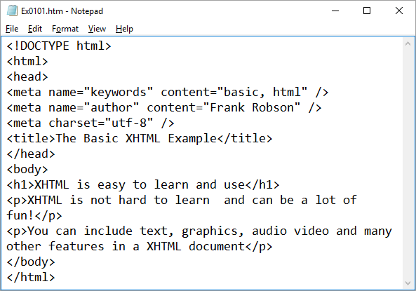
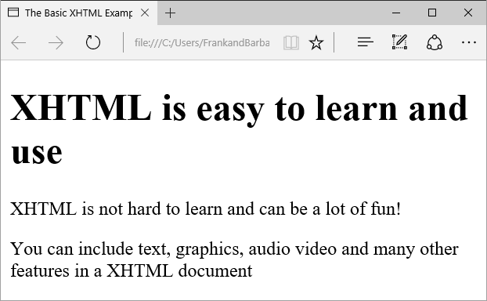
Example
The main elements are the DOCTYPE declaration, <html></html>, <head></head>, <title></title>, and <body></body> tags.
Some browsers are not very fussy about whether the tags are included or not, but other browsers are very fussy so you need to ensure that you include them as you will not be able to predict what browser someone is going to use.

Slide 26
DOCTYPE
<!DOCTYPE html>
This tag always begins an HTML document and defines the type of document. Older versions of HTML and XHTML used more complex document types eg: STRICT, TRANSITIONAL, and FRAMESET.
If a browser is told what to expect it will use a standard rendering mode.
If it is not it will use quirks mode which involves making best guesses about how to render a page. The latter can lead to unpredictable results depending on the browser used to view the page.

Slide 27
HTML
<html> </html>
These tags indicate that the file contains HTML-coded information.
The file extensions .html or .htm also indicate to the system that this is an HTML document.
It doesn’t matter which you use however the use of .htm seems to be becoming more common. It is important that when you decide to use one or the other, to continue to do so in order to avoid confusion.

Slide 28
HEAD
<head> </head>
The head section contains
the title
style formatting information which relates to the entire document
scripts for automation
meta tags containing information about the document
links to external stylesheets
links to external scripting files
There can only be one head section.

Slide 29
TITLE
<title> </title>
The title tag pair contains your document title which is displayed in the title bar at the top of the browser window or in the tab label.
The title is also what is displayed on someone's bookmark list, so choose a title which describes your web page. Search engines (e.g. Google or Yahoo) also use the title to identify your page.
There is only one title tag pair. Problems with the title tag pair can cause a page not to display any content.

Slide 30
BODY
<body> </body>
The body tag pair contains the content of your document which is displayed in the browser window. There can only be one body tag pair in the document.
The following basic tag pairs are used within the body of the document.

Slide 31
Headings
HTML has six heading levels: <h1></h1>, <h2></h2>, <h3></h3>, <h4></h4>, <h5></h5>, <h6></h6>. <h1> is the largest and should be used first. You can use the same heading tag many times in the same document.
When using multiple heading levels, use the levels in your document in the correct sequence. The sizes of the headings are preformatted (depending on the browser) so missing levels may give the document a strange appearance

Slide 32
Paragraphs
By default all white space (spaces, tabs, linefeeds, and carriage returns) is automatically converted to a single space when your document is displayed in a browser. If you want a line or paragraph break you need to specify it using a tag.
In the basic example shown in the Basic XHTML Document section, the first paragraph is coded as
<p>XHTML is not hard to learn and can be a lot of fun!</p>
In the source file there is a double space after the fullstop but only one in the display. Also the source file wraps after the word HTML but the browser wraps in a different place. A Web browser only starts a new paragraph when it encounters another <p> tag so the following source code would have the same effect as the code in the first example.
<p>XHTML is not hard to learn and can be a lot of fun!</p><p>You can include text, graphics, audio video and many other features in a XHTML document</p>

Slide 33
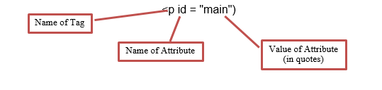
Attributes
Attributes are used to identify, format or provide required information to a tag pair. Text formatting should not be done in these tags and should be done using CSS3 which we will be covering later. Many browsers will however accept HTML formatting however it will not be accepted by the validator.
Attributes are made up of two parts, the name of the attribute (in lowercase) followed by an equals sign followed by the value of the attribute (in quotes). The quotes must always be used.

Slide 34
Meta Tags
Meta tags are used by the system to provide information to external sources. The meta tags are inserted in the head section of the document. Examples of meta tags are:
<meta name="keywords" content="basic, html" />
<meta name="author" content="Frank Robson" />
<meta charset="utf-8" />
This last meta tag is important as it is required if you want to use the HTML validator.
Note the / at the end of the meta tag. The meta tag does not exist as a tag pair so the tag ends with a space followed by the / (which we have seen used at the beginning of end tags). This tag format is used whenever a tag which does not have an end tag is used. This point will be highlighted later.

Slide 35

XHTML Validation
It is possible to ensure that the HTML code that you have written is correct by using an online HTML validator. In order to do this
go to the web address http://validator.w3.org
In the section Validate by File Upload click on the browse button and select the file that you want to check
Click the check button and wait for the results (This may take a little while depending on the size of the document).
If there are errors fix the first error then revalidate as multiple error messages may be related to a single error.
When the validator says that it is valid then the HTML code is correct.
Another advisable method of checking web pages is to test the web page in a variety of browsers (particularly the ones most likely to be used by the people accessing the webpage) to check that it is rendered correctly in each one.
Go to http://www.w3schools.com/browsers/browsers_stats.asp to see which browsers are currently the most popular e.g. in Nov and Dec 2015 the statistics for visitors to the W3Schools site indicate the following browser use

Slide 36
HTML Formatting

Slide 37
Introduction
Formatting of text can be done in HTML code however this is no longer recommended except for single pages and some small items of formatting which are not reused elsewhere on a website. The preferred method of formatting is using CSS which will be introduced in a later lesson.
If you attempt to use the HTML5 validator then many of the HTML formatting code will cause validation errors with a suggestion to use CSS instead.
The following notes are intended only as a guide for explaining how formatting can be achieved in the HTML code.

Slide 38
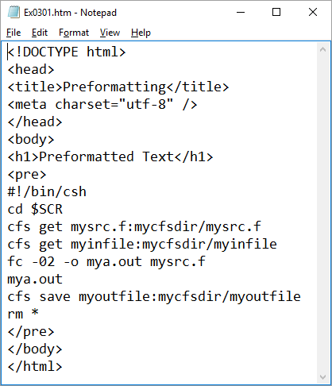
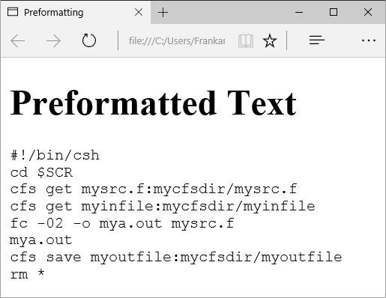
Preformatted Text
The <pre> tag (which stands for "preformatted") allows you to display text in a WYSIWYG (What you see is what you get) style.
This tag makes spaces, new lines, and tabs significant. Multiple spaces are displayed as multiple spaces, and line breaks are placed in the same locations as in the source HTML file. It uses the default font and font size of the browser.
This is useful for program listings, among other things. For example, the code on the left results in the output on the right.

Slide 39
The <pre> tag can be used with a width attribute that specifies the maximum number of characters for a line.
Hyperlinks can be used within <pre> sections. You should however avoid using other HTML tags within <pre> sections as some may not work and others may give strange results.
Since the characters <, >, and & have special meaning in HTML, you will need to use their escape sequences (&lt;, &gt;, and &amp;) to enter these characters. See the section on Escape sequences in a later lesson for more information.

Slide 40
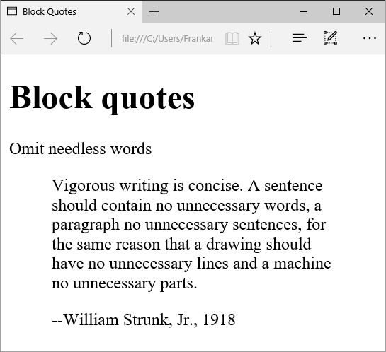
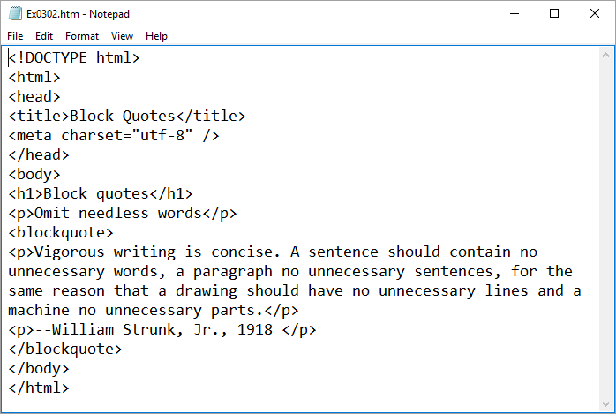
Extended Quotations
When quoting material from a book or other source you can use the <blockquote> </blockquote> tag pair.
This causes the quotation to be separated visually from the rest of the text. Most browsers do this by increasing the left and right margins for the quotation. In the following example notice the indentation both on the left and on the right

Slide 41
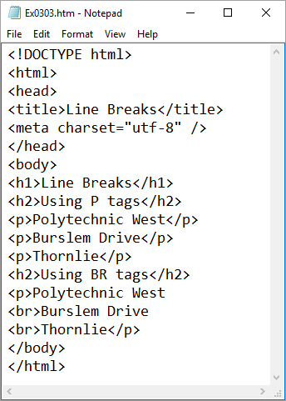
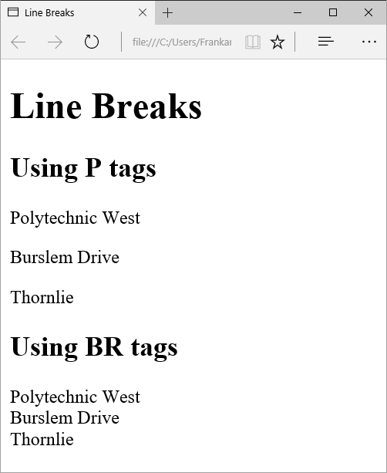
Line Breaks
When the <p> tag is used a line break results but there is also extra white space between one line and the next.
In order to get a line break without the extra vertical space, the <br> tag can be used.
This is useful in situation where you want a line break but the information on the lines relates to each other. For example, compare the two addresses in the following example and note the spacing between the lines of text.

Slide 42
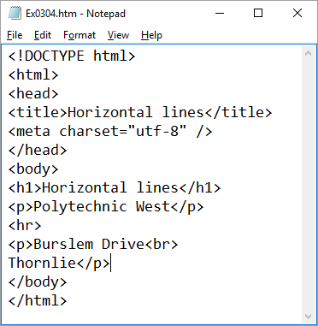
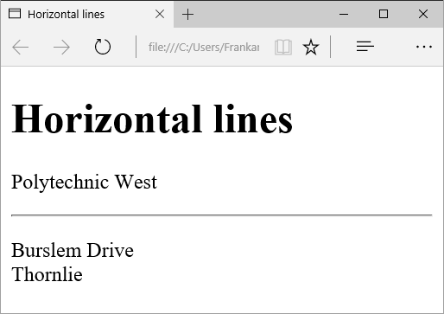
Horizontal Rules
Occasionally you might want to separate major sections of your document without using a lot of white space. The <hr> tag can be used to generate a horizontal line the width of the browser window (notice again the format of a tag that does not have an end tag).
The line’s size (or thickness) and width (the length of the rule) can be defined using CSS3.

Slide 43
Escape Sequences (a.k.a. Character Entities)
Character entities have two functions:
displaying characters which have special meaning in HTML e.g. ><&
displaying other characters not available on the keyboard (primarily characters with diacritic marks like é)
Three ASCII characters--the left angle bracket (<), the right angle bracket (>), and the ampersand (&)--have special meanings in HTML and therefore cannot be used "as is" in text.
The angle brackets are used to indicate the beginning and end of HTML tags, and the ampersand is used to indicate the beginning of an escape sequence.)
To use one of the three characters in an HTML document, you must enter its escape sequence instead:
For example compare the HTML code with the output

Slide 44
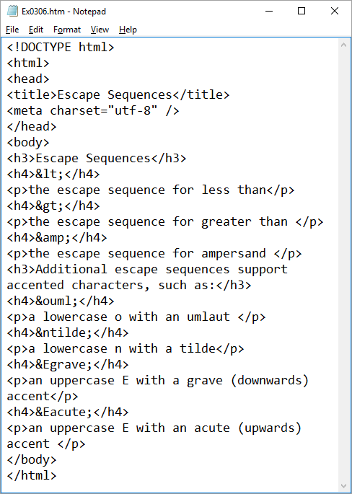
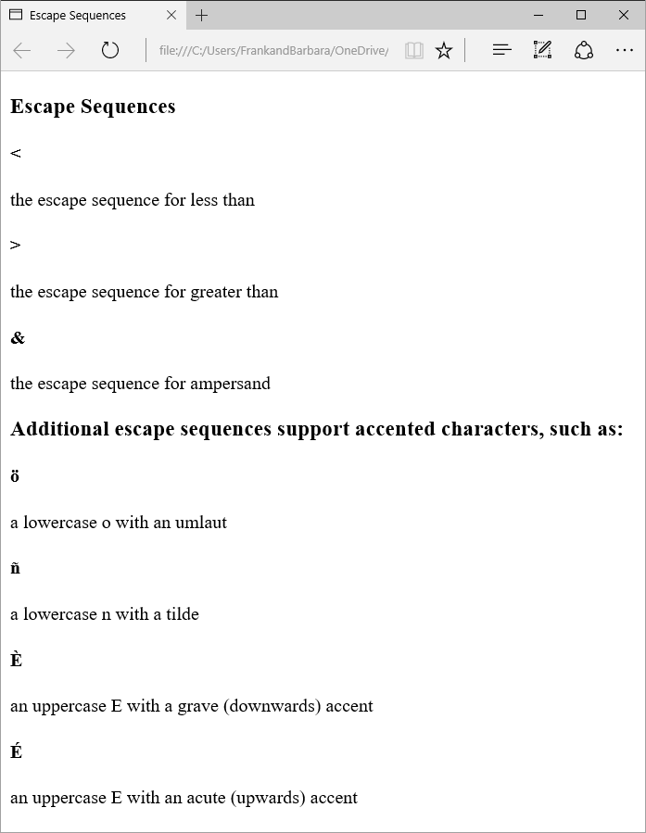
You can substitute other letters for the o, n, and E shown above. Visit https://www.w3.org/TR/2014/REC-html5-20141028/syntax.html#character-references
for a complete list of special characters.

Slide 45
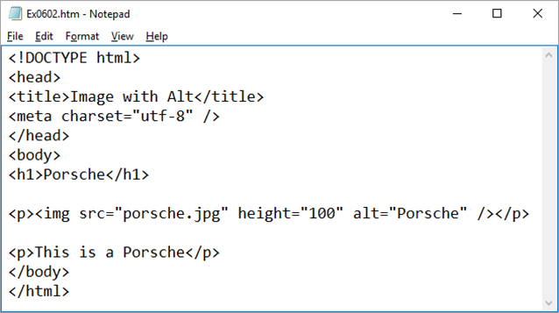
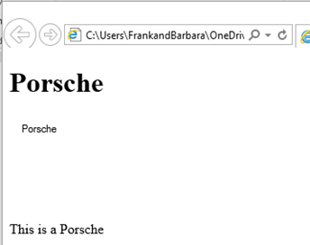
Alternate Text for Images
The alt attribute lets you specify text to be displayed instead of an image. For example:
where porsche.jpg is the picture of a porsche. With graphics-capable viewers that have image-loading turned on, you see the car. With a text-only browser or if image-loading is turned off, the word Porsche Image is shown in your window in place of the image.
Note: This tag is required in HTML5 so you need to include it whenever you use the img tag

Slide 46
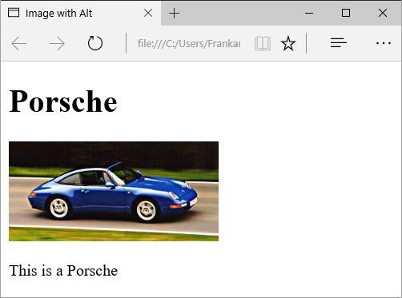

Image Size Attributes
You should include two other attributes on <img> tags to tell your browser the size of the images it is downloading with the text.
The height and width attributes let your browser set aside the appropriate space (in pixels) for the images as it downloads the rest of the file. Remember that scaling the image in this way does not in any way reduce or increase the size of the file being downloaded. If the file is 1Mbyte then making it the size of a postage stamp on screen will not make the file itself any smaller. Changing the size of the file needs to be done in a separate graphics package (eg PhotoShop, MSPaint etc).
If you put in only the width or the height then the browser will scale the other dimension of the image by the same proportion as the one you specify e.g. if you specify a height that is half the original then the width will be reduced by the same proportion.
For example the following example specifies the exact height of an image and the width is scaled by the same amount:

